Slide 1
JavaScript Introduction
JavaScript is a high-level programming language primarily used for creating interactive and dynamic web pages.
JavaScript runs on the client side and executed by the user’s web browser.

Slide 2
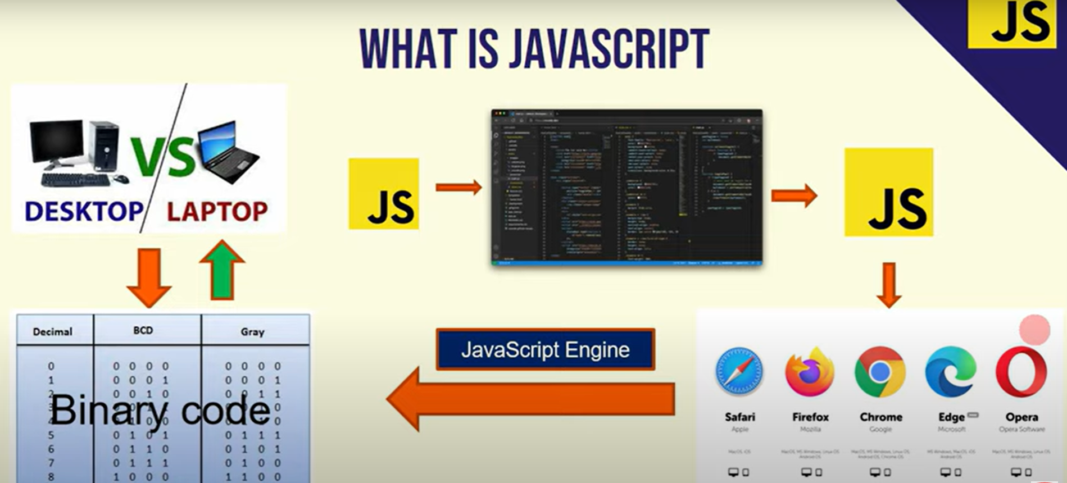
What is JavaScript and its Process

Slide 3
Advantages
Web applications
Mobile applications
Game development applications
Front end and backend both we can develop using JavaScript

Slide 4
Variables in JavaScript
In JavaScript, variables are used to store and manipulate data. They serve as named containers that hold values.
Variables types
var
let
Const
These are also called as keywords

Slide 5
var
Variables declared with var are function-scoped. This means that if a variable is declared anywhere else besides a function using var, it will always exist in the global scope.
Variable declared using var can be redeclared as well.
let
The ES6 introduced the let keyword, which lets you define variables that are block-scoped.
As with variables declared with const, the variables declared with let cannot be redeclared.
const
const is block-scoped. This means that the variable declared with const cannot be redeclared or reassigned.

Slide 6
var
function varExample() {
var x = 10;
console.log("Initial value of x:", x); // Output: 10
if (true) {
var x = 20; // Redeclared inside the block
console.log("Inside block, x:", x); // Output: 20
}
console.log("Outside block, x:", x); // Output: 20 (var is function-scoped)
}
varExample();

Slide 7
let
function letExample() {
let y = 30;
console.log("Initial value of y:", y); // Output: 30
if (true) {
let y = 40; // New variable inside block
console.log("Inside block, y:", y); // Output: 40
}
console.log("Outside block, y:", y); // Output: 30 (let is block-scoped)
}
letExample();

Slide 8
const
function constExample() {
const z = 50;
console.log("Value of z:", z); // Output: 50
// z = 60; // This would cause an error (Assignment to constant variable)
if (true) {
const z = 70; // Allowed, since it's a new block-scoped variable
console.log("Inside block, z:", z); // Output: 70
}
console.log("Outside block, z:", z); // Output: 50
}
constExample();

Slide 9
Data Types
String
Number
Boolean
Null
Undefined
Array
Object
Primitive Data Types
Complex Data Types

Slide 10
let name = "John";
console.log(name); // Output: John
let age = 25;
console.log(age); // Output: 25
test = 10>20;
console.log(test); // Output: false
let emptyValue = null;
console.log(emptyValue); // Output: null
let notDefined;
console.log(notDefined); // Output: undefined

Slide 11
Array
// Accessing elements
console.log(fruits[0]); // Output: Apple
// Adding an element to the end
fruits.push("Mango");
console.log(fruits); // Output: ["Apple", "Banana", "Cherry", "Mango"]
// Creating an array
let fruits = ["Apple", "Banana", "Cherry"];
// Removing the last element
fruits.pop();
console.log(fruits);
// Output: ["Apple", "Banana", "Cherry"]
// Iterating through an array
fruits.forEach(fruit => console.log(fruit));
// Finding an element
console.log(fruits.includes("Banana")); // Output: true

Slide 12
Object
// Accessing properties
console.log(person.name); // Output: John
// Modifying properties
person.age = 26;
console.log(person.age); // Output: 26
// Creating an object
let person = {
name: "John",
age: 25,
city: "New York"
};
// Checking if a property exists
console.log("city" in person); // Output: true
// Adding a new property
person.country = "USA";
console.log(person);
// Looping through an object
for (let key in person) {
console.log(`${key}: ${person[key]}`);
}

Slide 13
Operators & Expressions
Arithmetic operators
Assignment Operators
Comparison Operators
Logical Operators
Ternary Operators

Slide 14
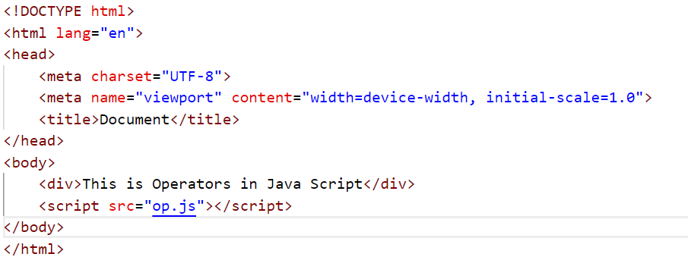
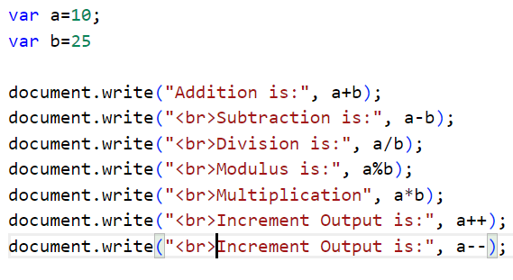

Slide 15
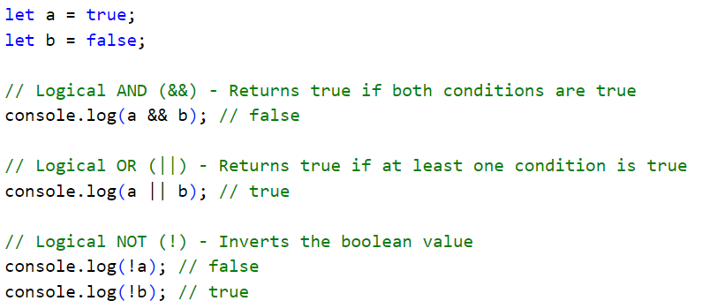
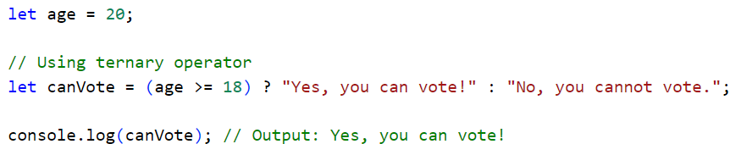

Slide 16
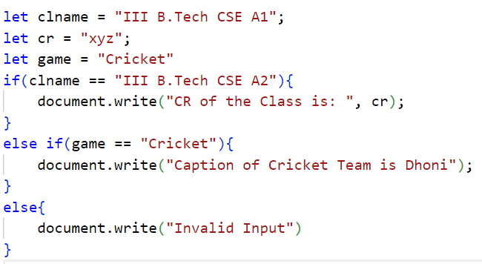
Conditional statements

Slide 17
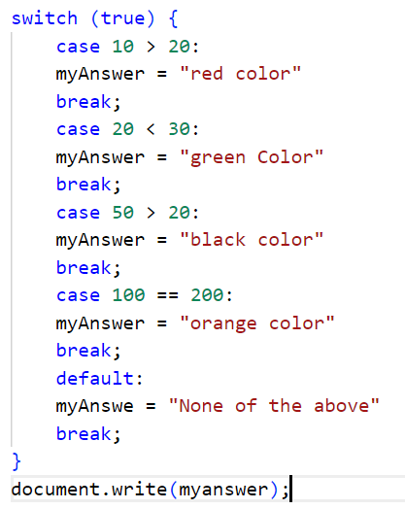
Switch statement

Slide 18
Dialogue Boxes in Java Script
alert
An alert box is used on the website to show a warning message to the user that they have entered the wrong value other than what is required to fill in that position.
Prompt
A prompt box is often used if you want the user to input a value before entering a page. When a prompt box pops up, the user will have to click either “OK” or “Cancel” to proceed after entering an input value. If the user clicks the OK button, the window method prompt() will return the entered value from the text box.
Confirm
A confirm box is often used if you want the user to verify or accept something. When a confirm box pops up, the user will have to click either “OK” or “Cancel” to proceed.

Slide 19
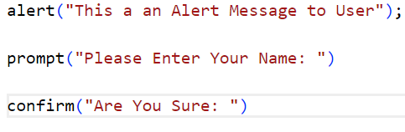
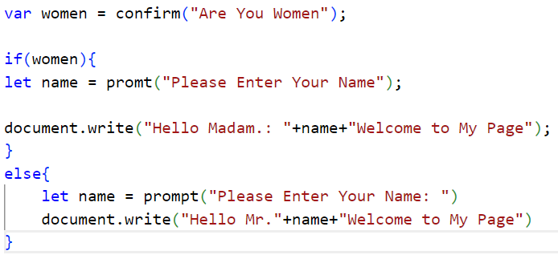

Slide 20
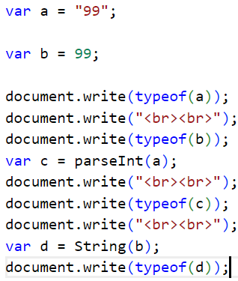
Type Conversion

Slide 21
Functions in Java Script
A JavaScript function is a block of code designed to perform a particular task.
A JavaScript function is executed when "something" invokes it (calls it).
A JavaScript function is defined with the function keyword, followed by a name, followed by parentheses ().
Function names can contain letters, digits, underscores, and dollar signs (same rules as variables).
The parentheses may include parameter names separated by commas: (parameter1, parameter2, ...)
The code to be executed, by the function, is placed inside curly brackets: {}

Slide 22
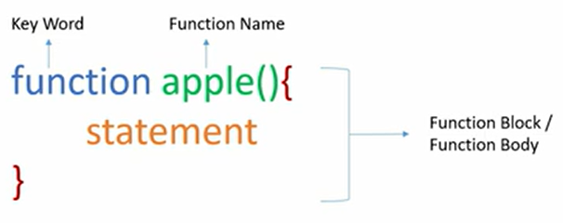

Slide 23
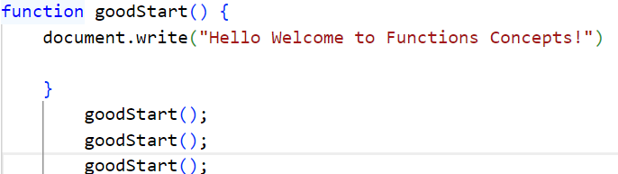

Slide 24
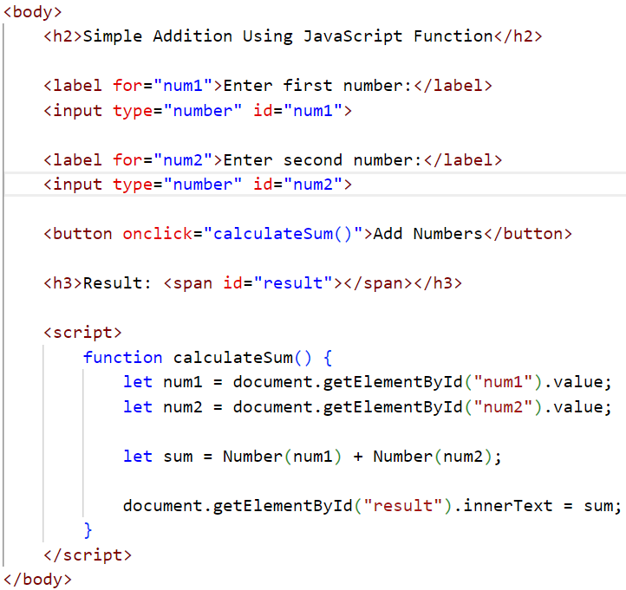
The user enters two numbers in the input fields.
When they click the "Add Numbers" button, the calculateSum() function runs.
The function retrieves values from the input fields, converts them to numbers, adds them, and displays the result in the <span> element.

Slide 25
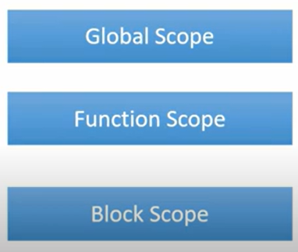
Scopes

Slide 26
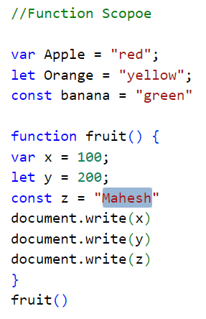
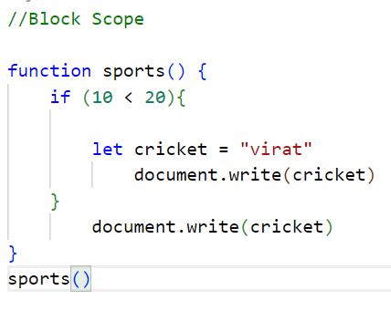
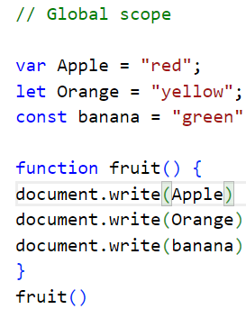

Slide 27
Function Expression
Anonymous Function
Function with parameters and Return Value

Slide 28
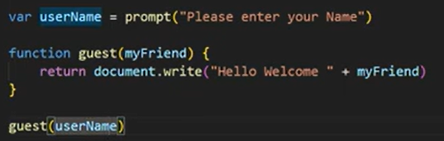
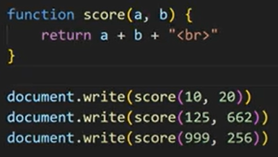
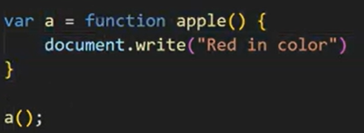
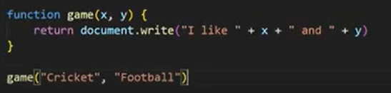
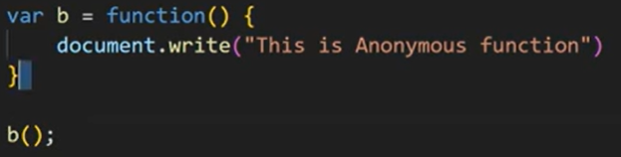

Slide 29
Methods in Java Script
Array Methods
String Methods
Object Methods

Slide 30
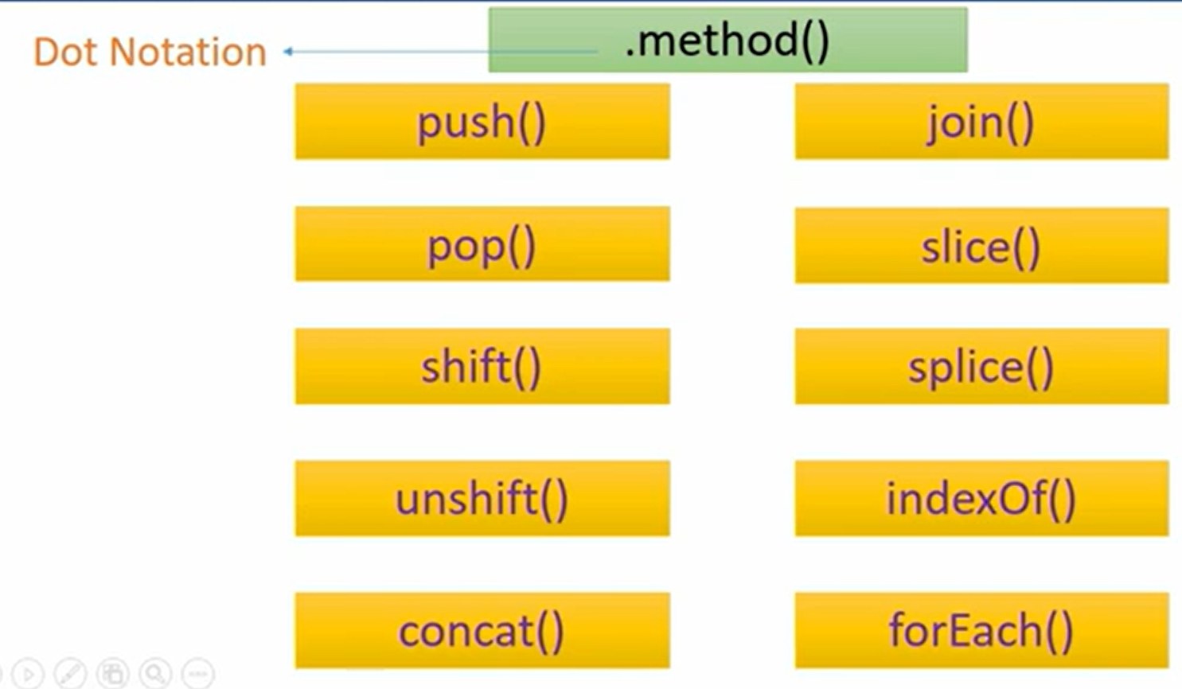
Javascript Array Methods

Slide 31
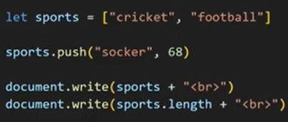
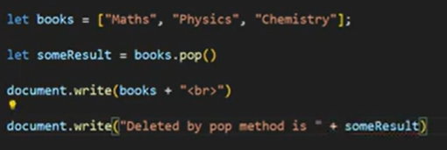
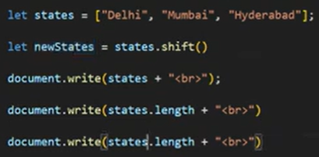
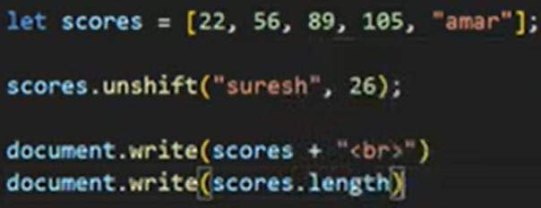
Shift Method Removes the first element from an array and returns that element.
Unshift Adds one or more elements to the beginning of an array and returns the new length.

Slide 32
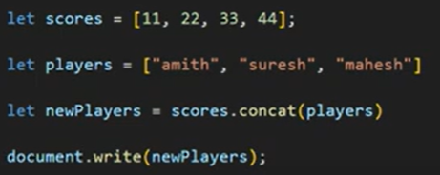
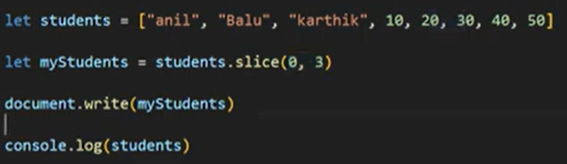
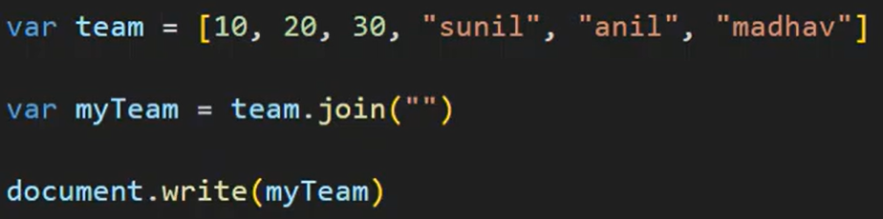

Slide 33
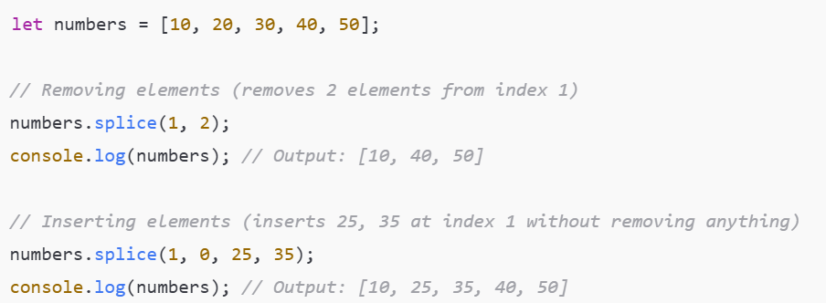
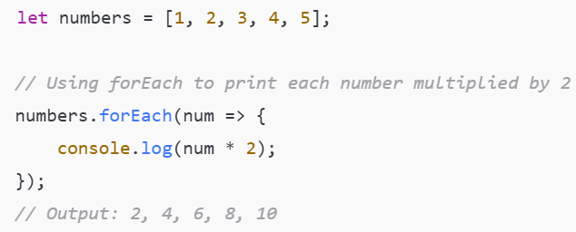
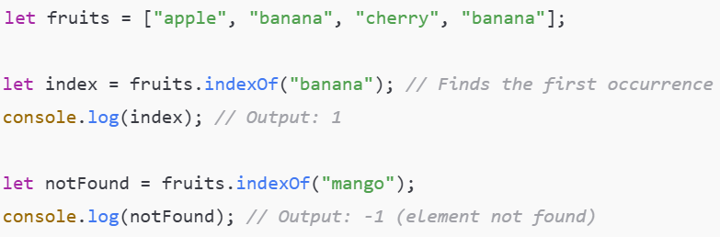

Slide 34
Javascript String Methods
length
toUpperCase() & toLowerCase()
indexOf()
includes()
substring()
slice()
replace() & replaceAll()
trim(), trimStart(), trimEnd()
split()
charAt() & charCodeAt()

Slide 35
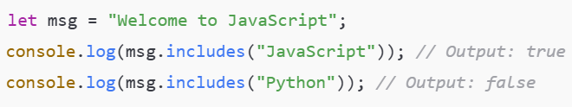
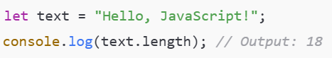
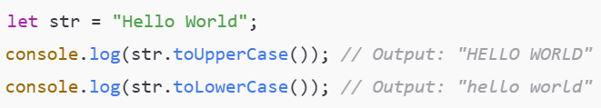
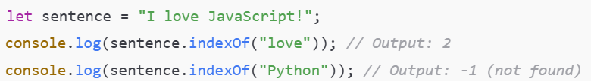
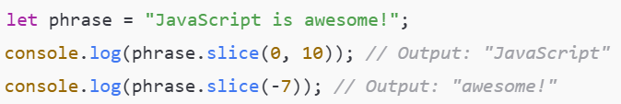
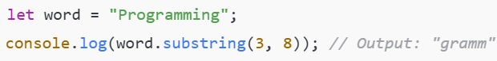

Slide 36
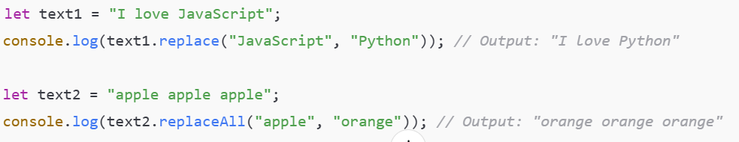
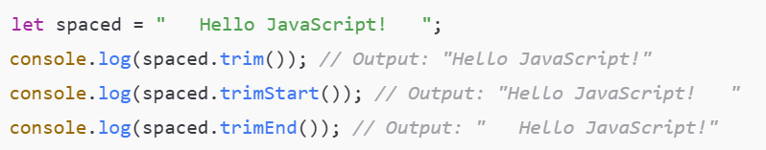
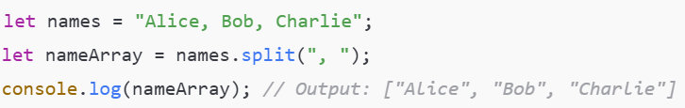
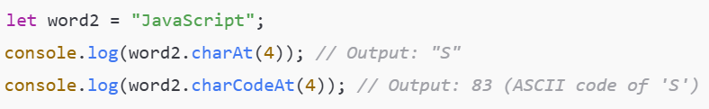

Slide 37

JavaScript object methods
Object.keys() – Get all keys of an object
Object.values() – Get all values of an object
Object.entries() – Get an array of key-value pairs
Object.assign() – Copy properties from one object to another
Object.freeze() – Prevent modifications to an object
Object.seal() – Prevent adding/removing properties but allows
hasOwnProperty() – Check if an object has a specific property
Object.fromEntries() – Convert an array of key-value pairs into an object
Object.create() – Create a new object with a prototype
Object.defineProperty() – Define a new property with specific behavior

Slide 38
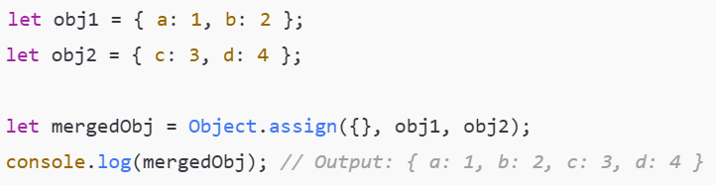
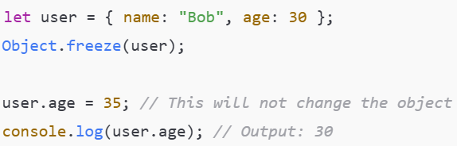

Slide 39
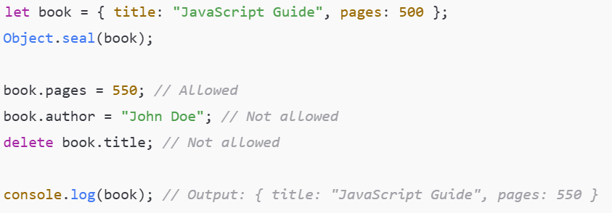
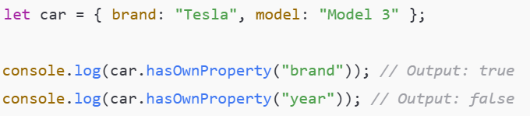
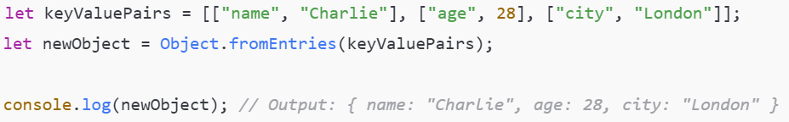

Slide 40
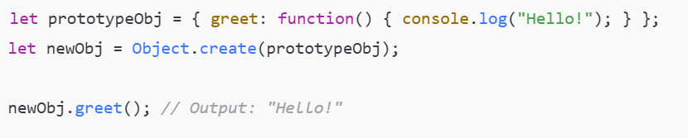
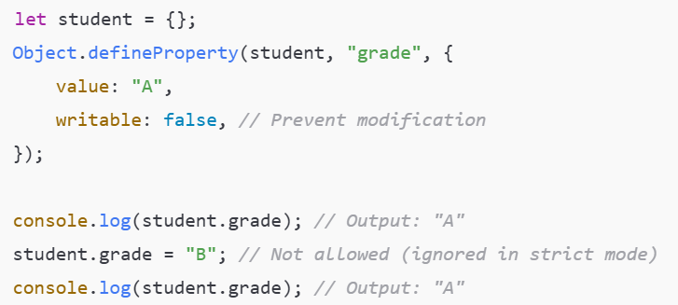

Slide 41

Extend Objects in JavaScript
Extending objects in JavaScript can be done in multiple ways depending on the use case:
Object.assign() or spread operator (...) for shallow copies.
Object.create() or Object.setPrototypeOf() for prototypal inheritance.
Classes (class & extends) for class-based inheritance.

Slide 42



Slide 43


Slide 44


Slide 45


Slide 46

OOP in JavaScript
Objects and Properties
Methods (Functions inside objects)
Encapsulation (Hiding details and exposing only necessary parts)
Inheritance (Extending one object/class from another)
Polymorphism (Overriding methods for different behaviors)

Slide 47


We can Create Objects and we can assign values to it, and we can create
Constructors as well in javascript

Slide 48

Why Use Prototypes?
Methods in Person.prototype are shared across all instances.
Reduces memory usage compared to defining methods inside the constructor.

Slide 49

ES6 Classes (Modern OOP in JavaScript)
ES6 introduced the class keyword, making OOP more structured.
Advantages of Using Classes
✔ More readable and structured ✔ Works the same way as prototype-based inheritance ✔ Easy to use for developers coming from Java, C++, Python

Slide 50

Encapsulation, a fundamental concept of object-oriented programming that groups data and functions into a single unit called an object. It helps to protect data from misuse and interference by limiting access to the object's internal state. Using Private Fields (#)

Slide 51

Polymorphism (Method Overriding) Polymorphism allows a subclass to modify a method from its superclass.

Slide 52

Static Methods Static methods belong to the class, not to instances.
✅ JavaScript supports both prototype-based and class-based OOP. ✅ OOP helps in organizing code into reusable and maintainable components. ✅ Concepts like inheritance, encapsulation, and polymorphism make JavaScript more powerful.

Slide 53
In ES5, inheritance is implemented using constructor functions and prototypes.
// Parent Constructor Function
function Person(name) {
this.name = name;
}
// Adding a method to Person's prototype
Person.prototype.sayHello = function() {
console.log("Hello, my name is " + this.name);
};
// Child Constructor Function (Inheriting from Person)
function Student(name, grade) {
Person.call(this, name); // Call Parent Constructor
this.grade = grade;
}
// Inherit methods from Person
Student.prototype = Object.create(Person.prototype);
Student.prototype.constructor = Student; // Reset constructor reference
// Adding a method to Student
Student.prototype.study = function() {
console.log(this.name + " is studying in grade " + this.grade);
};
// Creating an instance of Student
var student1 = new Student("Alice", 10);
student1.sayHello(); // Output: Hello, my name is Alice
student1.study(); // Output: Alice is studying in grade 10
ES5 approach requires more steps compared to ES6 classes but achieves the same result!

Slide 54
In ES6, inheritance is done using the class and extends keywords, making it more readable and structured.
// Parent Class
class Person {
constructor(name) {
this.name = name;
}
sayHello() {
console.log(`Hello, my name is ${this.name}`);
}
}
// Child Class (Inheriting from Person)
class Student extends Person {
constructor(name, grade) {
super(name); // Calls the Parent Class Constructor
this.grade = grade;
}
study() {
console.log(`${this.name} is studying in grade ${this.grade}`);
}
}
// Creating an instance of Student
let student1 = new Student("Alice", 10);
student1.sayHello(); // Output: Hello, my name is Alice
student1.study(); // Output: Alice is studying in grade 10

Slide 55


